Slide 1
Evolution
Chapter 13, Lessons 2 & 3 Outlines

Slide 2
A. Charles Darwin
Charles Darwin was a(n) naturalist, a person who studies plants and animals by observing them.
Darwin was not the first to develop a theory of evolution, but his theory is the one best supported by evidence today.
The type of tortoise, mockingbird, and finch that live on each of the Galapagos Islands was slightly different; Darwin later figured out that some varieties were different enough to be classified as difference species.

Slide 3
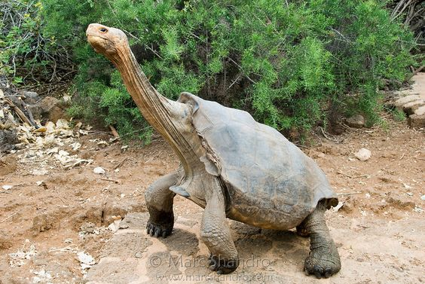
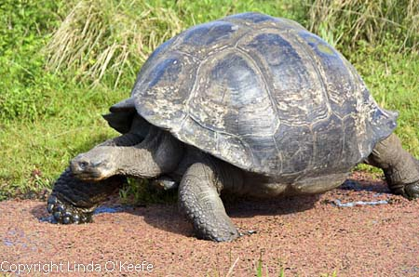
B. Darwin’s Theory
Darwin noticed that there was a relationship between each species and the food sources of the island it lived on.
The species of tortoise that lived on an island with tall cacti had long necks; the species of tortoise that lived on an island with lots of short grass had short necks.

Slide 4
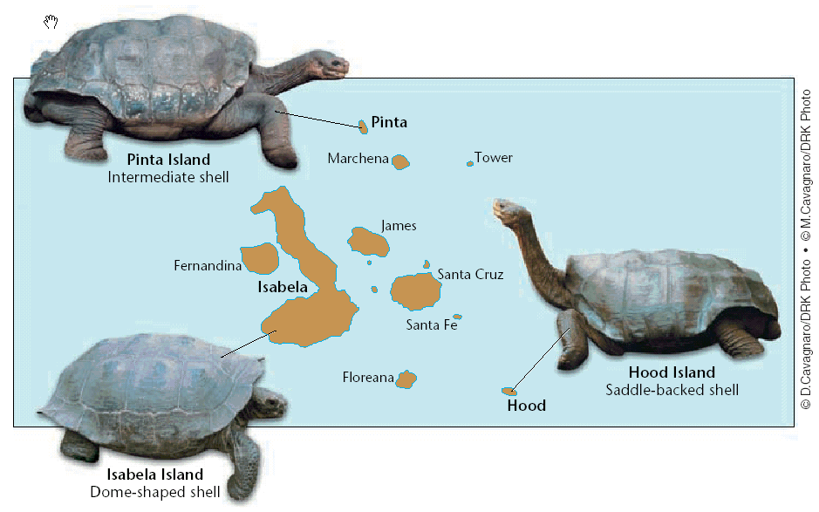
B. Darwin’s Theory
3. Darwin though all the Galapagos tortoises shared a common ancestor that came to one of the islands millions of years ago.
4. Darwin knew that in any species, members of the same species each have slight differences, called variations.

Slide 5
B. Darwin’s Theory
a. Darwin knew that food is a(n) limiting resource, so members of a species that live in the same area compete for food.
b. If a variation benefited a tortoise, allowing it to compete for food better than other tortoises, the tortoise lived longer, reproduced more, and passed on its variations to its offspring.

Slide 6
B. Darwin’s Theory
Natural selection is the process by which populations of organisms with variations that help them survive in their environments:
- live longer,
- compete better,
- and reproduce more
than populations that do not have the variations.

Slide 7
C. Adaptations
A(n) adaptation is a characteristic of a species that enables the species to survive in its environment.
Scientists classify adaptations into three categories.

Slide 8
C. Adaptations
a. Structural adaptations involve shape, size, color and other physical features; the length of the Galapagos tortoise species’ neck is an example of this type of adaptation.

Slide 9
C. Adaptations
b. Behavioral adaptations involve the way organisms at; hunting at night is an example of this type of adaptation.

Slide 10
C. Adaptations
c. Functional adaptations involve internal body systems that affect organisms’ biochemistry; expanding blood vessels that cool a jackrabbit’s blood is an example of this type of adaptation.

Slide 11
C. Adaptations
A structural adaptation that aids members of a species in blending in with their environment is called camouflage.
4. An adaptation in which one species resembles another species is called mimicry.
5. The living and nonliving parts of the environment are always changing; species that cannot adapt to such changes will become extinct.

Slide 12
D. Artificial Selection
Darwin’s theory of evolution by natural selection predicts that species will develop adaptations and, therefore, eventually closely match Earth’s changing environment.
Selective breeding is the breeding of organisms for desired characteristics.

Slide 13
D. Artificial Selection
Darwin realized that natural selection and selective breeding are similar processes.
In natural selection, nature causes the changes in the species; in selective breeding, humans cause the changes in the species
For this reason, Darwin called selective breeding artificial selection.
4. Artificial selection explains and supports Darwin’s theory.

Slide 14
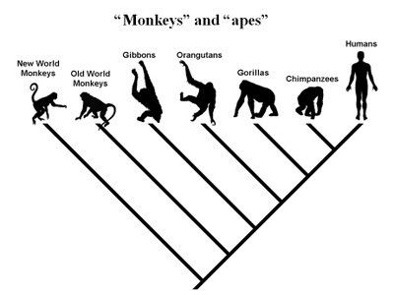
A. Evidence for Evolution
Evolution does not occur in a straight line with one species replacing another in a series of orderly steps.
a. Living species that are closely related share a common ancestor.
b. How closely related two species are depends when they diverged, or split, from their common ancestor.

Slide 15
A. Evidence for Evolution
2. The study of similarities and differences among structures and living species is called comparative anatomy.
a. Body parts of organisms that are similar in position but different in function are called homologous structures. The forelimbs of different mammals are examples.
b. If species have homologous structures, this suggests that the species are related.

Slide 16
A. Evidence for Evolution
c. The more similar two structures are to each other, the more likely it is that the species have evolved from a recent common ancestor.

Slide 17
A. Evidence for Evolution
Analogous structures are body parts that perform a similar function but differ in structure. The wings of flies and birds are examples.
e. The existence of analogous structures indicates that the species are not closely related.

Slide 18
A. Evidence for Evolution

Slide 19
A. Evidence for Evolution
Body parts that have lost their original function through evolution are called vestigial structures. The wings of flightless birds are an example.

Slide 20
A. Evidence for Evolution
The best explanation for vestigial structures is that the species that have vestigial structures are related to ancestral species that still use the structures for a specific purpose.
b. Whales have a tiny pelvic bone, which is a vestigial structure for walking on land.

Slide 21
A. Evidence for Evolution
Studying the development of embryos can also provide scientists with evidence that certain species are related.
a. Embryology is the study of the development of embryos from fertilization to birth.

Slide 22
A. Evidence for Evolution
All species of vertebrates have pharyngeal pouches are some stage during their development.
The similarities in location and function of the pharyngeal pouches is a sign that the vertebrate species share a common ancestor.

Slide 23
A. Evidence for Evolution
The study of gene structure and function is called molecular biology.
The existence of genes provides evidence of evolution because they have been shown to be the source of variation upon which natural selection acts.
The more closely related two species are, the more similar their genes and proteins are.

Slide 24
A. Evidence for Evolution
c. Studies in molecular biology have shown that some stretches of DNA that are common to many species change through time at steady, predictable rates like a kind of molecular clock.
d. Scientists use this molecular clock to estimate the time in the past when living species diverged from common ancestors.

Slide 25
B. The Study of Evolution Today
Since the publication of Darwin’s theory, scientists have confirmed, refined and extended his work.
Scientific studies of fossils, anatomy, embryology, and molecular biology have provided evidence of relatedness among living and extinct species.
The continuous discovery of new fossils that have features of species that lived before and after them is strong evidence of evolution of species.

Slide 26
B. The Study of Evolution Today
4. Scientists today are studying how genes can be reorganized in simple ways that cause dramatic changes in organisms.
5. Though scientists now study evolution at the molecular level, the basic principles of Darwin’s theory of evolution by natural selection have remained unchanged for more than 150 years.

