Slide 1
Body Systems and Functions

Slide 2
Flash Cards
Law of Conservation of Mass & Law of Conservation of Energy in the Environment
Photosynthesis
Cellular respiration
Carbon cycle
Organ Systems
Pathogens

Slide 3
1. Law of Conservation of Mass & Law of Conservation of Energy in the Environment
Mass and energy are never created nor destroyed
The amount of matter present at the beginning of a chemical reaction is the same amount produced by the reaction
Energy and matter are continuously exchanged between organisms and their physical environment
Matter and energy are recycled over and over again (ex. animals and plants exchange oxygen and carbon dioxide)

Slide 4
2. Photosynthesis
H2O + CO2 + solar radiation → C6H12O6 + O2
How plants create nutrients
Green plants use chlorophyll to capture sunlight
Sunlight is used to split water (H2O) molecules to release hydrogen molecules
Hydrogen combines with carbon dioxide (CO2) from the environment to make the sugar glucose (C6H12O6)
Oxygen (O2) is released into the environment as a waste product

Slide 5
3. Cellular Respiration
C6H12O6 + 6O2 → 6CO2 + 6H2O + Energy (ATP)
Organisms (plants and animals) break down glucose to release energy (ATP)
Type of aeorobic respiration – requires O2
Releases CO2 and H2O

Slide 6
4. Carbon Cycle
A.k.a. carbon-hydrogen-oxygen cycle
Carbon, hydrogen and oxygen are recycled in the environment by photosynthesis and cellular respiration
Animals use the oxygen released by plants during photosynthesis for cellular respiration, which releases CO2 used for photosynthesis
Carbon can also be cycled through the environment through other processes, such as burning of fossil fuels and decomposition

Slide 7
5. Organ Systems
Provide specific functions to maintain homeostasis, while also working together to maintain body functions
Some other organ systems rely on other organ systems to function (ex. all organ systems rely on the circulatory system for oxygen and nutrients)
Some organs can belong to more than one organ system (ex. gonads belong to reproductive and endocrine systems)

Slide 8
Respiratory System
Life function: respiration
Removes carbon dioxide from blood and exchanges it for oxygen
Consists of pharynx, trachea, bronchi, bronchioles, alveoli and lungs
Maintains homeostasis by maintaining O2 and CO2 balance in the body
Disorders: bronchitis, asthma and emphysema

Slide 9
Immune System
Life function: regulation
Fights diseases and infections in the body
Consists of white blood cells and lymph nodes
Maintains homeostasis by protecting the body from harmful pathogens
Disorders: Type 1 diabetes, AIDS, psoriasis, arthritis

Slide 10
Reproductive System
Life function: reproduction
Produces egg and sperm cells and provides mechanisms to increase the species number
Consists of ovaries, uterus, cervix, urethra, prostate, genitals and gonads
Does not help to maintain homeostasis
Disorders: cancers, male and female infertility

Slide 11
Excretory System
Life function: excretion
Removes wastes from the bloodstream
Consists of lungs, liver, skin, kidneys, urethra
Maintains homeostasis by removing metabolic wastes such as ammonia, urea, salts, water, CO₂, etc.
Disorders: kidney disease, gout

Slide 12
Nervous System
Life function: regulation
Detects stimuli, secretes chemical and electrical signals, and controls all other organ systems
Consists of neurons, nerves, brain and spinal cord
Maintains homeostasis by controlling and regulating the other parts of the body
Disorders: cerebral palsy, meningitis, stroke, polio, dementia/Alzheimers

Slide 13
Endocrine System
Life function: regulation
Releases hormones into the blood to communicate with target cells
Consists of hypothalamus, pituitary gland, thyroid and parathyroid glands, adrenal glands, gonads
Maintains homeostasis by keeping chemicals in the body at a normal level
Disorders: goiter, diabetes, pituitary gland disorders

Slide 14
Digestive System
Life function: nutrition
Uses enzymes to break down food and release nutrients into the blood stream. Also removes solid wastes from the body.
Consists of stomach, mouth, esophagus, intestines, liver and pancreas
Maintains homeostasis by breaking down food for nutrients and breaking down toxic substances and removing them from the body
Disorders: ulcer, diarrhea, constipation, gallstones

Slide 15
Musculoskeletal System
Life function: locomotion (movement)
Works together to move the body
Consists of bones, cartilage, joints, muscles, tendons, ligaments
Maintains homeostasis by generating heat for the body through muscular contraction
Disorders: arthritis, tendonitis

Slide 16
Circulatory System
Life function: transport
Delivers nutrients and oxygen to cells and carries metabolic waste and carbon dioxide away from the cells
Consists of heart, arteries, veins, blood cells, plasma, platelets, bone marrow
Maintains homeostasis by stabilizing body temperature and heat and providing life sustaining materials to different parts of the body
Disorders: high blood pressure, heart attack, anemia, leukemia

Slide 17
6. Pathogens
A.k.a. infectious agents
Something that causes a disease or infection that can be spread from one individual to another
Include viruses, parasites, bacteria and fungi
Your body produces white blood cells to ingest and destroy pathogens
Can be avoided by:
Washing your hands often
Not drinking contaminated water
Not eating undercooked food

Slide 18
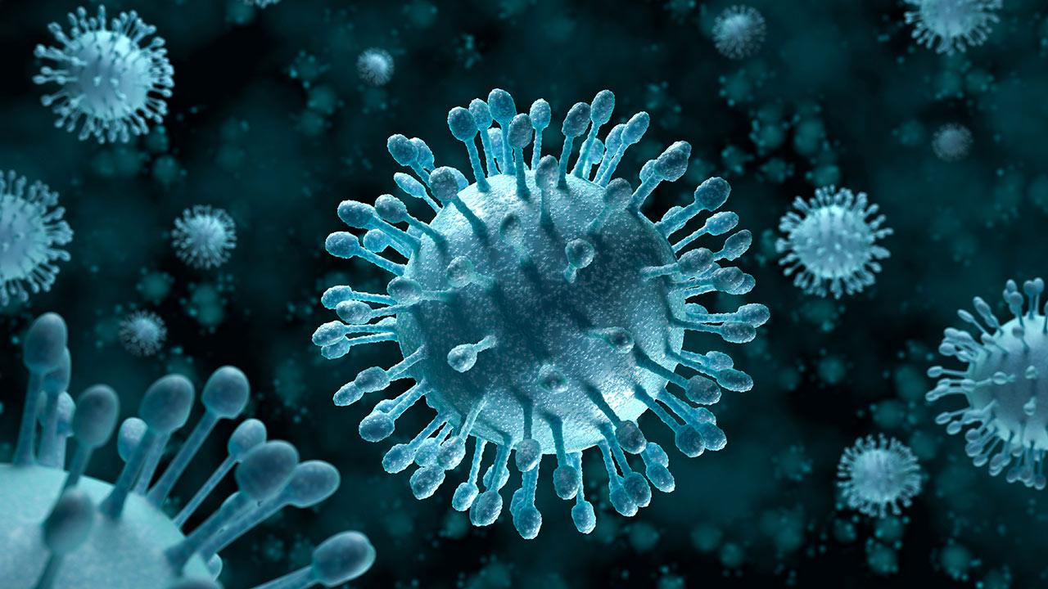
Virus
Takes over a host cell, injects its own genetic material and forces the cell to produce more viruses
Examples: smallpox, influenza, mumps, measles, chickenpox, Ebola, HIV
Blood-borne (transmitted via bodily fluids)
Can be prevented with vaccinations and treated with anti-viral drugs (NOT antibiotics)

Slide 19
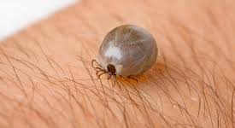
Parasite
Latches on to a host (internally or externally) and takes nutrients from the host for its own use
Example: malaria, lice, ticks, fleas
Can be transmitted through contaminated food or water, via other animals or insects, blood-borne or air-borne
Can be treated with clinical medicines

Slide 20
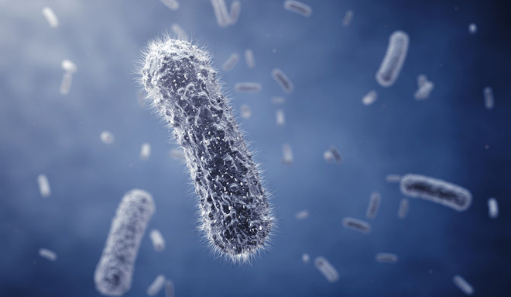
Bacteria
Destroys cells by releasing toxins or direct damage
Example: pneumonia, typhoid fever, E. coli (food poisoning)
Air-borne, water-borne, blood-borne
Can be prevented by vaccination and treated with antibiotics

Slide 21
Fungi
Types of fungus that becomes parasitic
Example: athlete’s foot, common in plants
Transmitted through exposure to soil
Can be treated with fungicides

Slide 22
Some infectious agents can be beneficial
Exposure to pathogens can strengthen your immune system (antibodies)
Gut bacteria aids in food digestion and brain health
Viruses could potentially kill harmful bacteria or aid in agriculture
Parasites, such as maggots, can actually prevent infection

Slide 23
Antibiotics
Antibiotics can only treat bacteria, not viruses
Over-prescription of antibiotics can lead to antibiotic resistance (bacteria become immune to antibiotics and becomes harder to kill)
Overuse of certain hand sanitizers can also lead to antibiotic resistance
Antibiotic resistance can lead to “superbugs,” bacteria that are much more deadly than regular bacteria

