Slide 1
heredity
n. the passing on of physical or mental characteristics genetically from one generation to another.

Slide 2
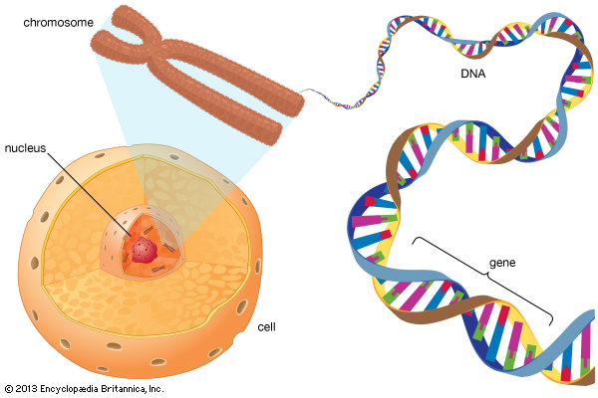
A. What controls traits?
Inside each cell is a nucleus that contains threadlike structures called chromosomes
Mendel’s factors are parts of chromosomes, and each cell in offspring contains chromosomes from both parents
A(n) gene is a section on a chromosomes that has genetic information for one trait.

Slide 3
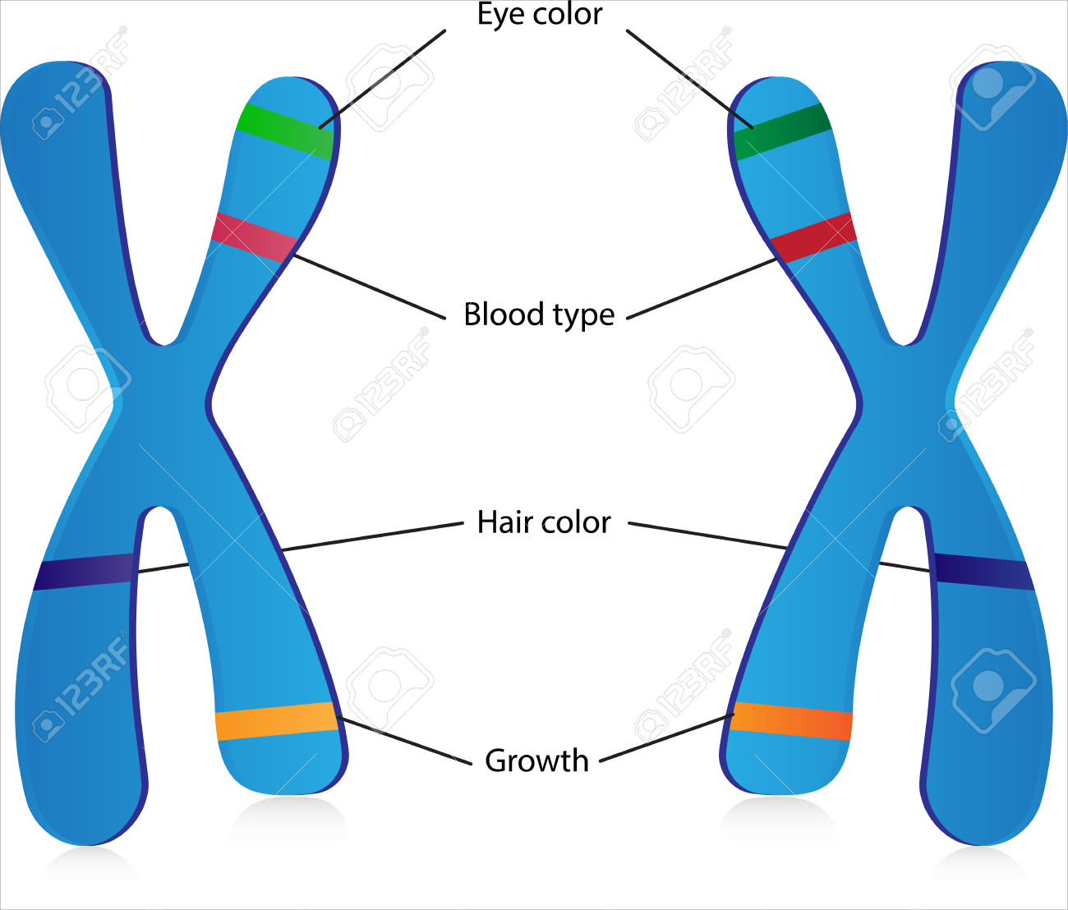
A. What controls traits?
4. The different forms of a gene are called alleles.
5. Geneticists refer to how a trait appears, or is expressed, as the trait’s phenotype.
6. The two alleles that control the phenotype of a trait are called the trait’s genotype.

Slide 4
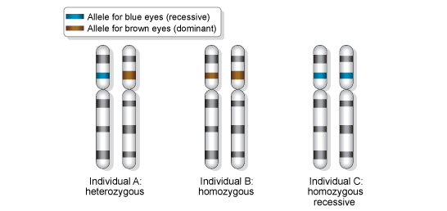
A. What controls traits?
In genetics, uppercase letters represent dominant alleles, and lowercase letters represent recessive alleles.
When two alleles of a gene are the same, its genotype is homozygous.
If two alleles of a gene are different, its genotype is heterozygous.

Slide 5
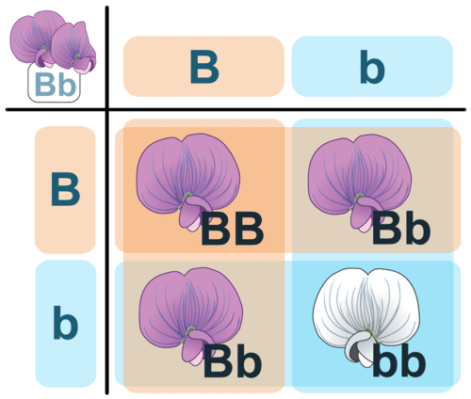
b. Modeling inheritance
In a situation based on chance, such as flipping a coin, the chance of getting an outcome can be represented by a(n) ratio such as 50:50 or 1:1.
A(n) Punnett square is a model that is used to predict possible genotypes and phenotypes of offspring.

Slide 6
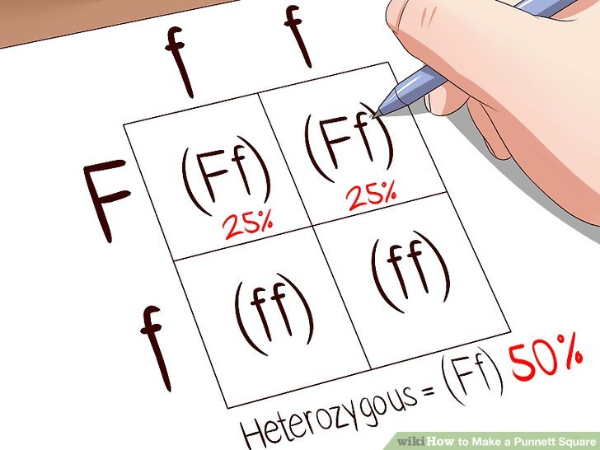
b. Modeling inheritance
To create a Punnett square, you need to know the genotype of both parents.
If you count large numbers of offspring from a particular cross, the overall ratio will be close to the ratio predicted by the Punnett square.

Slide 7
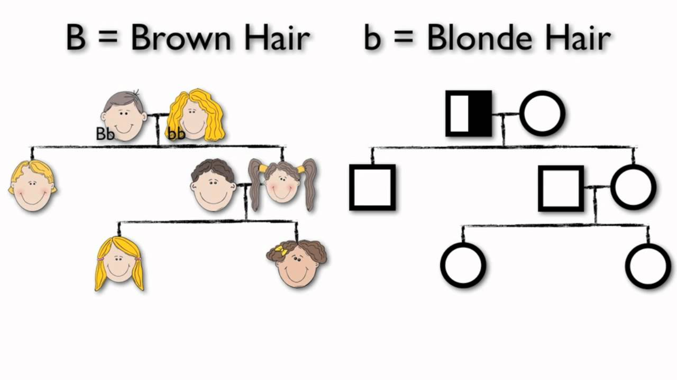
b. Modeling inheritance
3. A(n) pedigree is a diagram that shows phenotypes of genetically related family members. It also gives clues about their genotypes.

Slide 8
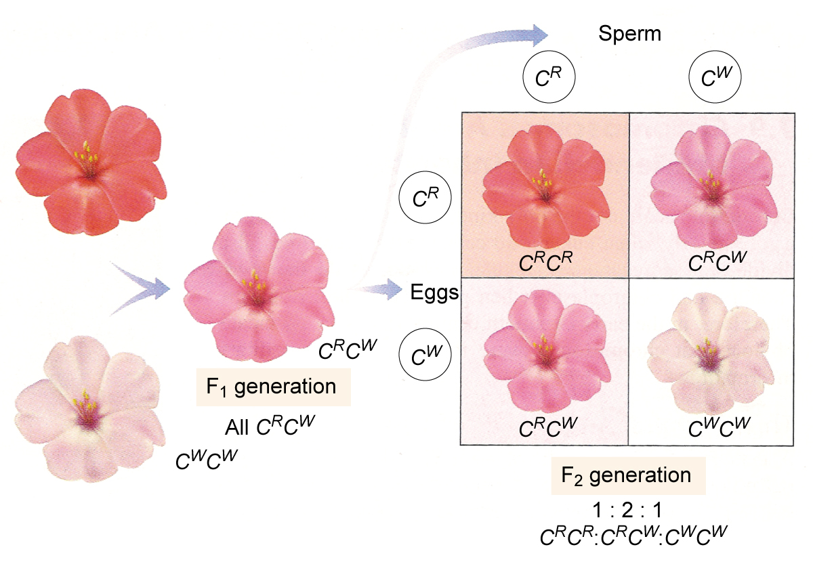
C. Complex patterns of inheritance
Alleles show incomplete dominance when the offspring’s phenotype is a blend of the parents’ phenotypes.
ex. skin color

Slide 9
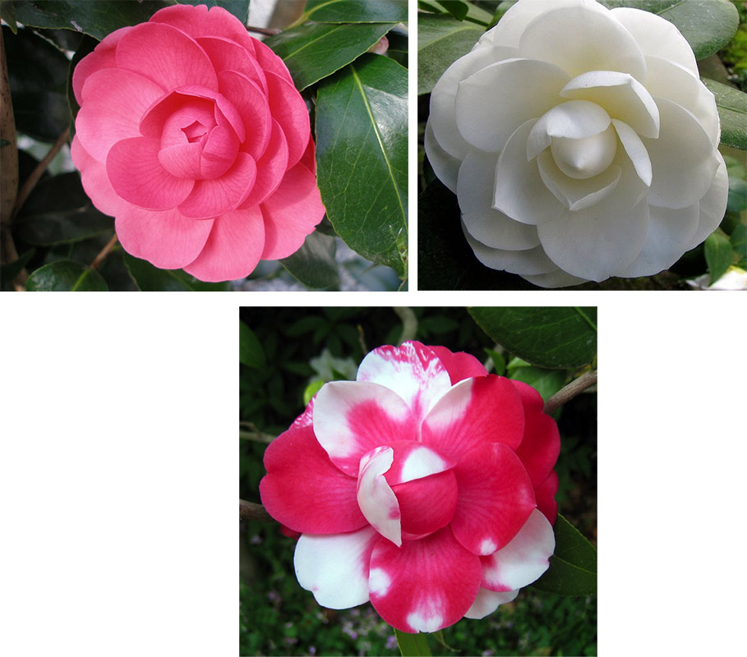
C. Complex patterns of inheritance
2. Alleles show codominance when both alleles can be observed in a phenotype.
ex. calico cats

Slide 10
C. Complex patterns of inheritance
Unlike the genes in Mendel’s pea plants, some genes have multiple alleles.
4. ABO blood type is a trait that is determined by multiple alleles.

Slide 11
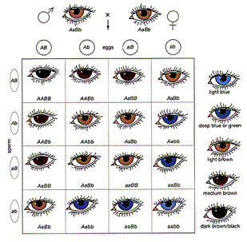
C. Complex patterns of inheritance
5. Polygenic inheritance occurs when multiple genes determine the phenotype of a trait.
6. Human eye color is an example of polygenic inheritance.

Slide 12
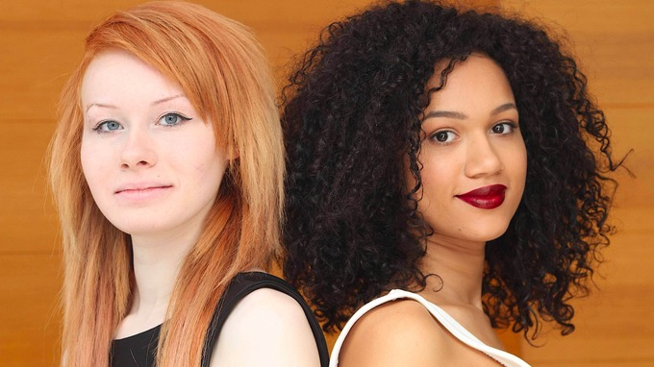
Genetics have tons of possibilities

Slide 13
d. Genes and the environment
Genes are not the only factors that can affect phenotypes. An organism’s environment can also affect its phenotype.
The flower color of one type of hydrangea is determined by the soil in which the hydrangea grows.
Healthy choices can affect a person’s phenotype.

Slide 14
Nature vs. nurture
How much are you affected by your genetics and how much are you influenced by your environment?
Mix of both?
Ex. intelligence, obesity

Slide 15
Heredity Project
Find a partner
Identify each partner’s phenotypes and determine genotypes for given traits
Draw Punnett squares for each trait
Randomly select traits of hypothetical offspring
Draw offspring
Completed projected should include lists of phenotypes and genotypes, Punnett squares and drawing
Extra credit is possible is your project is neat, thorough and organized

Slide 16
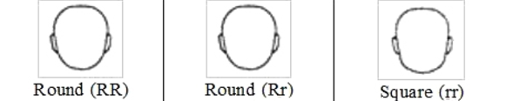
Face shape

Slide 17

Cleft chin

Slide 18
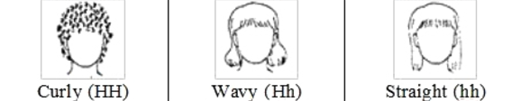
Hair

Slide 19
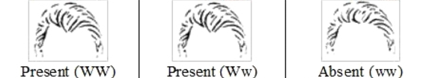
Widow’s peak

Slide 20

Eye spacing

Slide 21

Eye shape

Slide 22

Eye size

Slide 23

Eyelash length

Slide 24
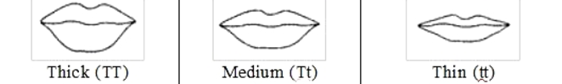
Lip shape

Slide 25

Mouth size

Slide 26

Freckles

Slide 27

dimples

Slide 28
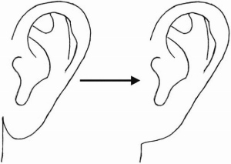
earlobes

Slide 29
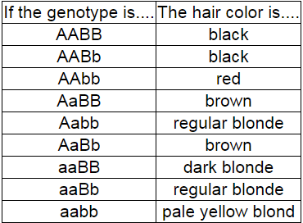
Hair color

Slide 30
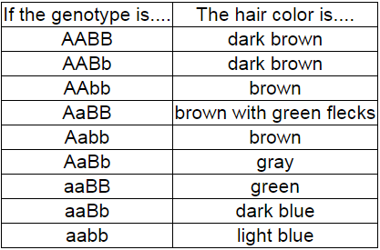
Eye color

Slide 31
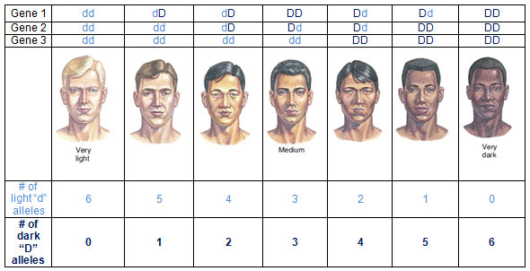
skin color (polygenic inheritance)

